Slide 1
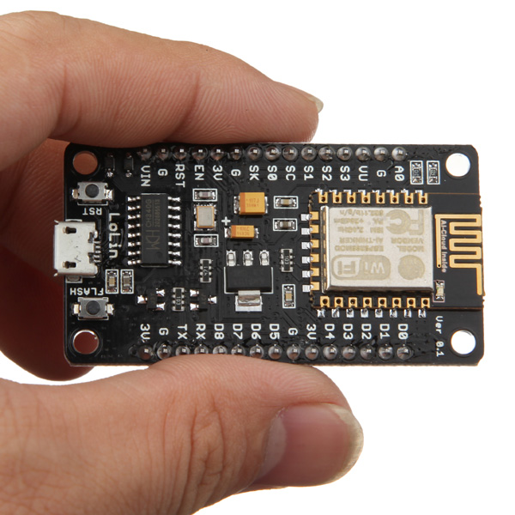

IoT with the ESP8266
and NodeMCU Firmware
Jason Follas Sr. Software Engineer Quicken Loans
@jfollas

Slide 2
Agenda
Espressif makes a highly integrated SoC known as the ESP8266-EX that combines a microcontroller with a Wi-Fi stack on the same silicon. This chip, combined with flash memory and an antenna, is sold as a FCC/CE-approved module for under US$3. Breadboard-friendly DevKits that combine the module with USB serial port and power components are available for under US$7.
This talk is not a sales pitch for Espressif, though. Rather, we will explore how to write software for this tiny platform, primarily focusing on the use of an open-source firmware known as NodeMCU. Using scripts written in Lua, we’ll see how to connect to a network, read data from other devices and sensors, and communicate with services on the internet – the types of activities that a tiny Thing would need to do!

Slide 3
In my experience, the Internet of Things is kind of expensive…

Slide 4
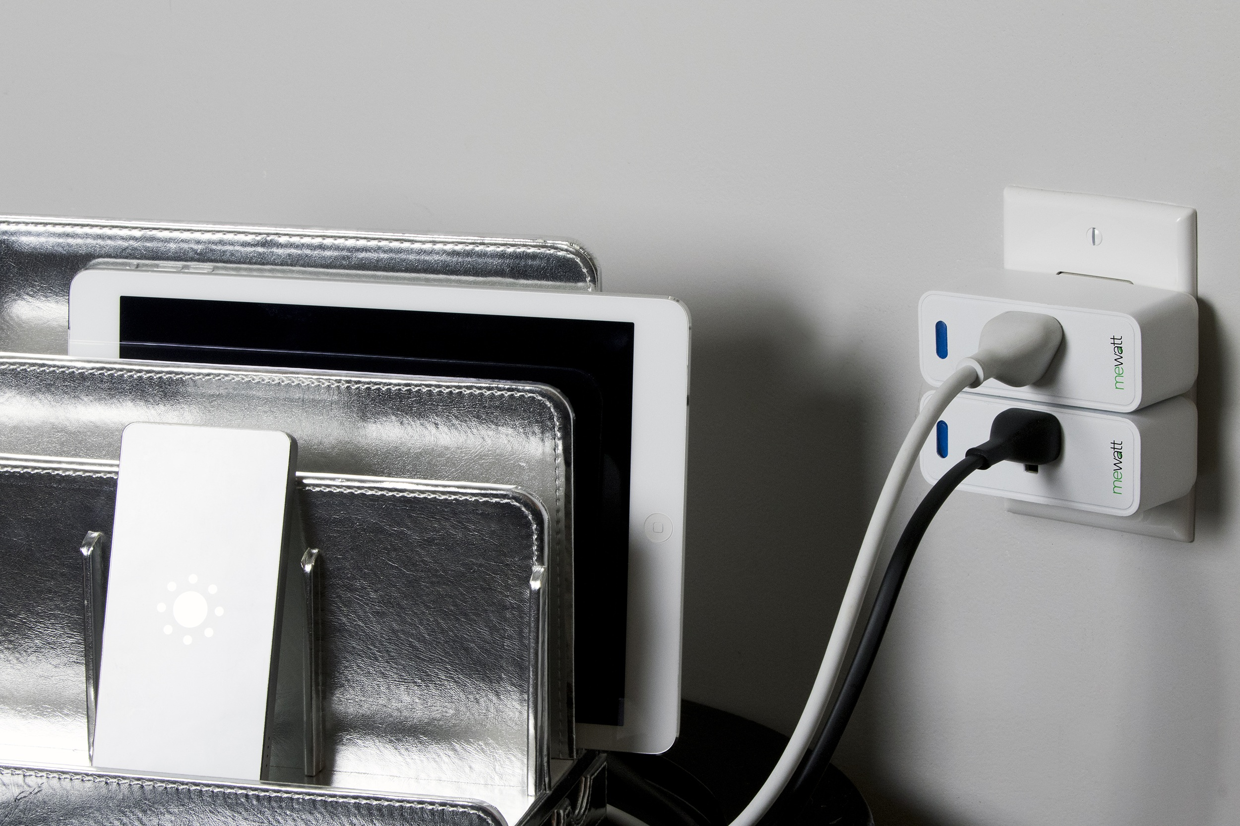

Slide 5

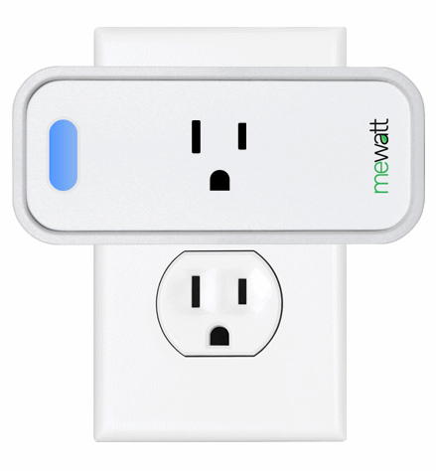
Energy Metering
Send to Cloud
5-Second Sleep

Slide 6
We needed a platform.

Slide 7
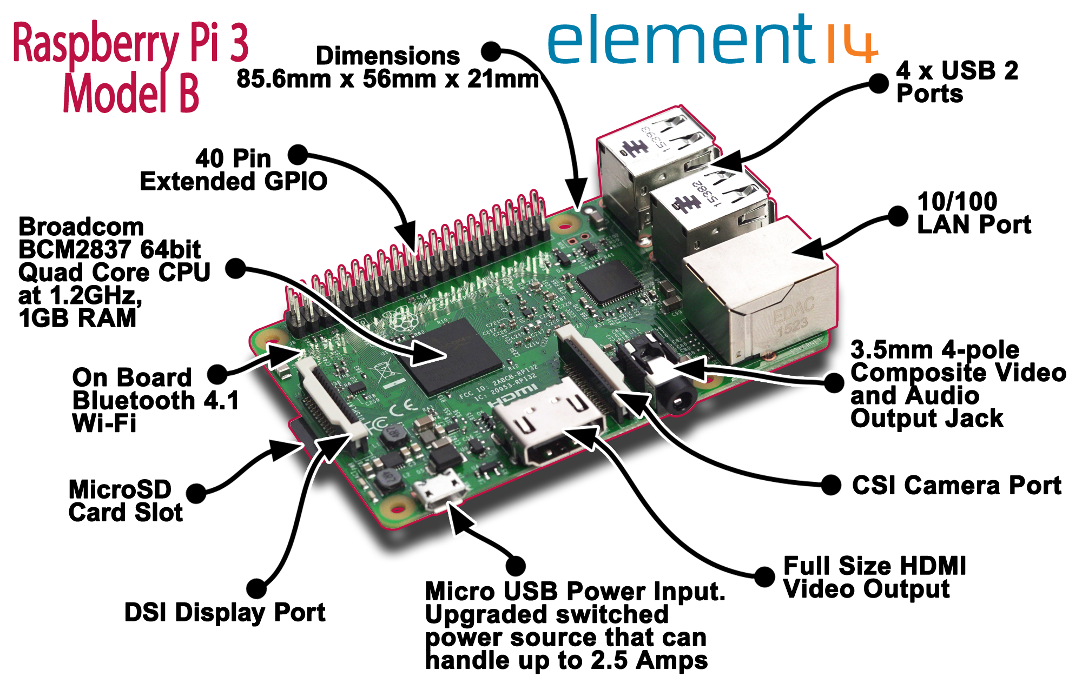
Raspberry Pi 3
$40

Slide 8
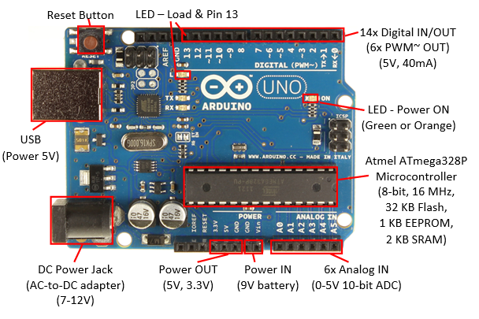
Arduino UNO R3
$25

Slide 9
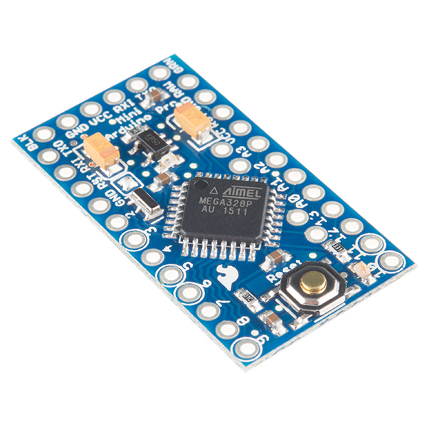
Arduino Pro Mini 328
32KB Flash
1KB EEPROM
2KB SRAM
5VDC
Atmel ATmega328 16MHz
$10
8 Analog Pins 14 Digital Pins

Slide 10
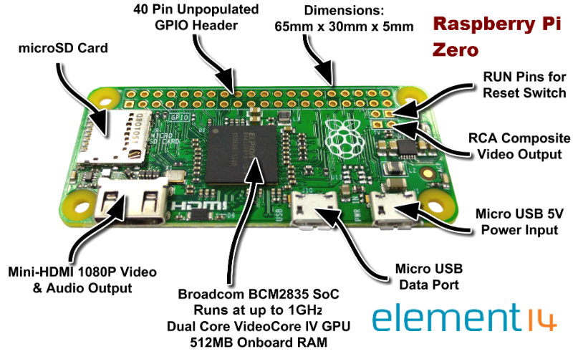
Raspberry Pi Zero
$5

Slide 11
But what about the “I” in IoT?

Slide 12
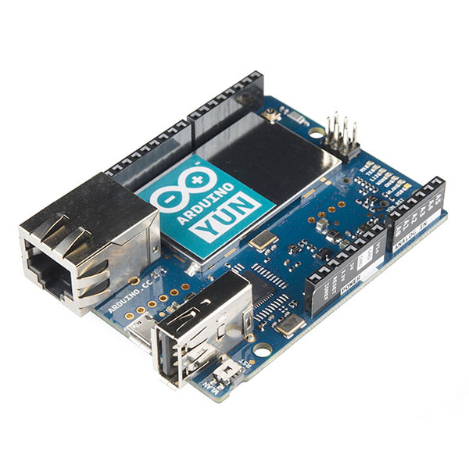
Arduino Yun
ATmega32u4 +
Atheros AR9331
$80

Slide 13
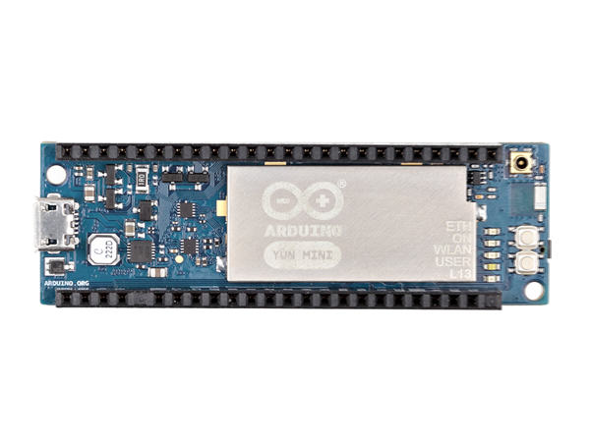
Arduino Yun Mini
ATmega32u4 +
Atheros AR9331
$65

Slide 14
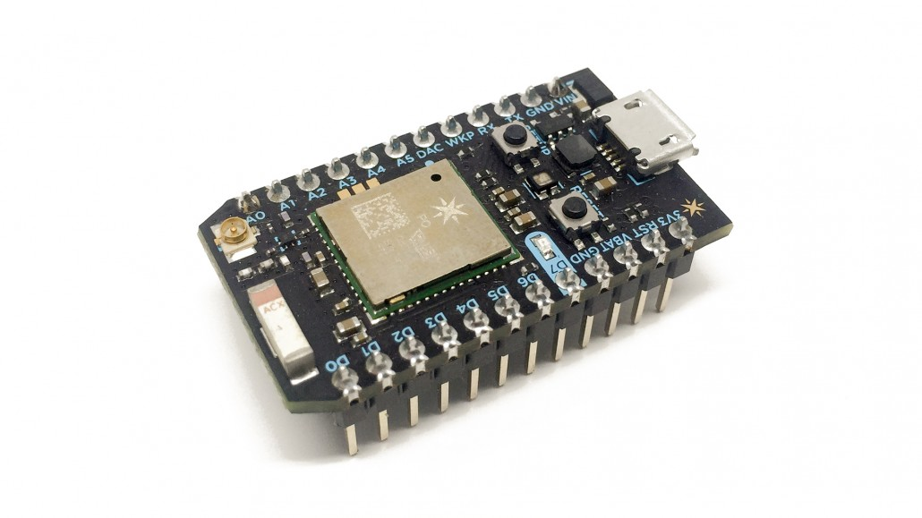
Particle Photon
Broadcom BCM43362 Wi-Fi Chip
STM32 120MHz Cortex M3 128KB RAM 1MB Flash
$20
Particle Cloud

Slide 15
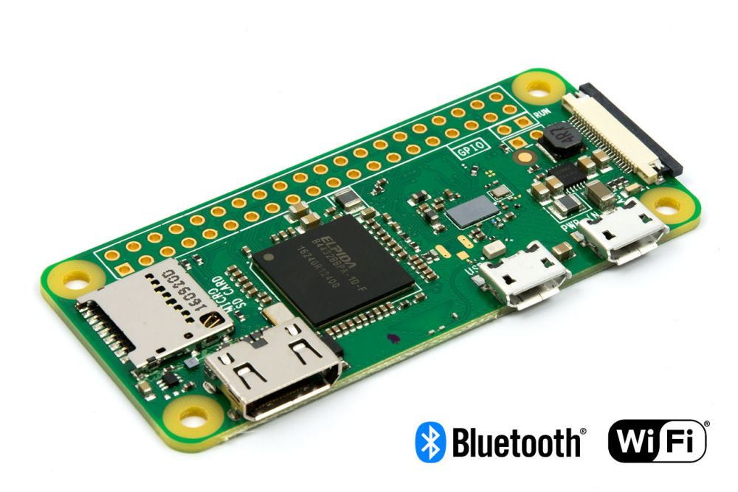
Raspberry Pi Zero W
$10

Slide 16
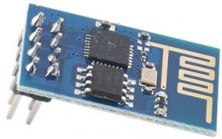
ESP8266-01 Serial-to-Wi-Fi
802.11 b/g/n
AT commands
$2

Slide 17
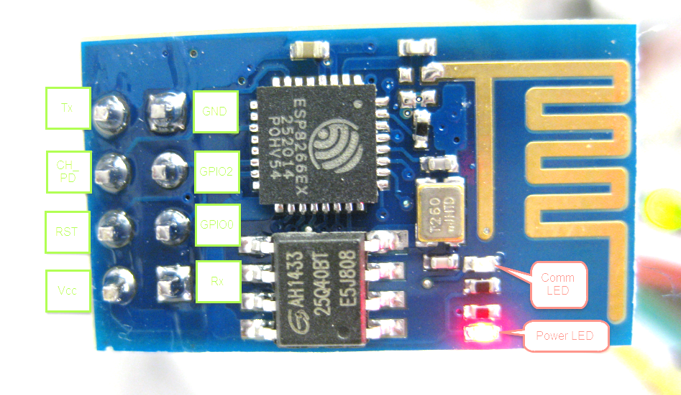
Tx
GND
CH_ PD
GPIO2
RST
GPIO0
Rx
Vcc

Slide 18
Introducing the ESP8266

Slide 19

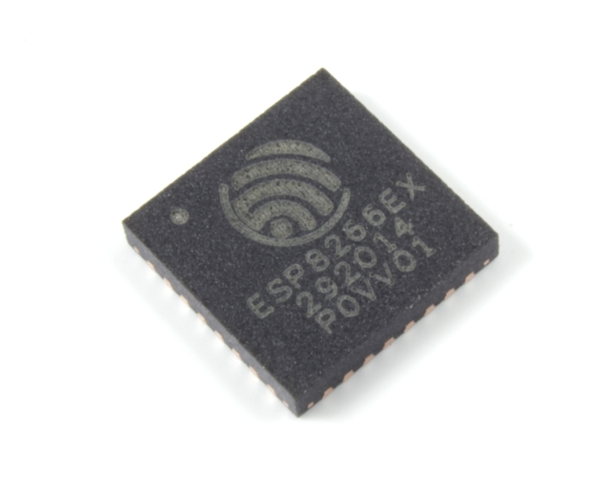

ESP8266EX
Microcontroller
RAM
Wi-Fi
GPIO

Slide 20
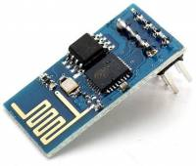
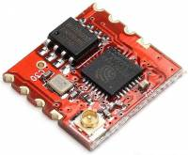
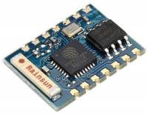
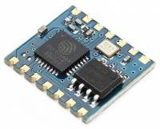
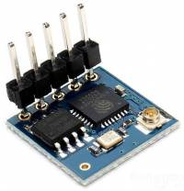
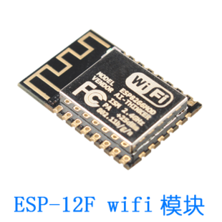
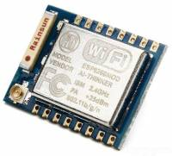
AI Thinker Modules

Slide 21
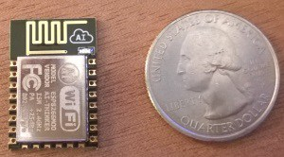
AI Thinker Modules

Slide 22
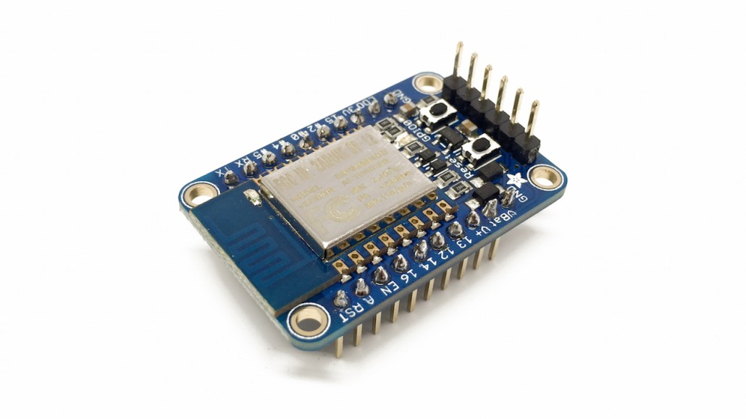
Breadboard-friendly Dev Kits
$10
Adafruit ESP8266 Huzzah

Slide 23
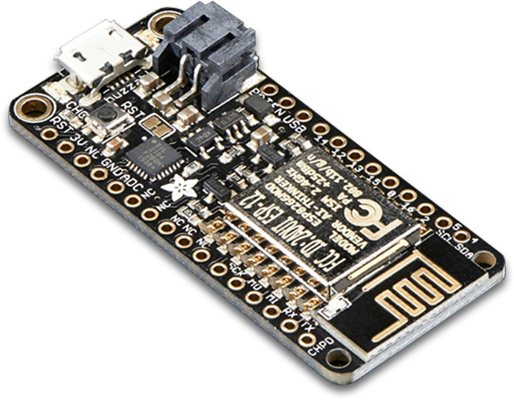
Breadboard-friendly Dev Kits
$16
Adafruit Feather Huzzah

Slide 24
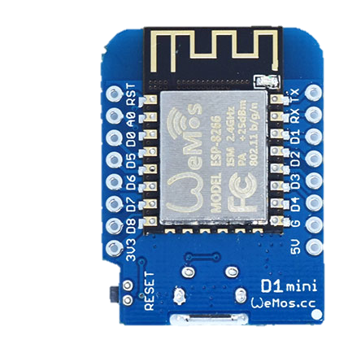
Breadboard-friendly Dev Kits
$4
Wemos D2

Slide 25
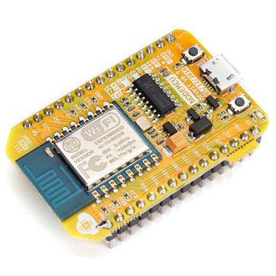
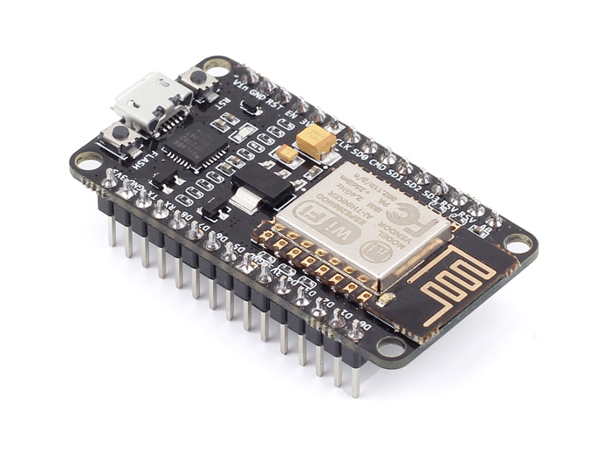
Breadboard-friendly Dev Kits
$5
NodeMCU DevKit

Slide 26
ESP8266 By The Numbers

Slide 27
ESP8266 By The Numbers
32
32-bit RISC processor based on the Tensilica Xtensa Core

Slide 28
ESP8266 By The Numbers
80/160
80MHz or 160MHz (selectable in software)

Slide 29
ESP8266 By The Numbers
<1
Price of the ESP8266EX chip itself

Slide 30
ESP8266 By The Numbers
2
Price of the ESP8266-12F module by AI Thinker

Slide 31
ESP8266 By The Numbers
3.3
3.3 Volts

Slide 32
ESP8266 By The Numbers
80/35
80 KB Data RAM 35 KB Instruction RAM (Harvard architecture)

Slide 33
ESP8266 By The Numbers
16
GPIO Pins

Slide 34
ESP8266 By The Numbers
1
Analog-Digital Converter 0-1 VDC range

Slide 35
ESP8266 By The Numbers
802.11
802.11 b/g/n Wi-Fi built into the silicon

Slide 36
ESP8266 By The Numbers
2.4
2.4 GHz radio band only

Slide 37
ESP8266 By The Numbers
30,000,000+
Chips sold

Slide 38
Wi-Fi
802.11 b/g/n, 2.4 GHz band only
Modes:
Station
SoftAP
Station + SoftAP
Warning: Only one radio channel! Station+SoftAP must share

Slide 39


Power Requirements
40 uA idle
400 mA spikes (i.e., during Wi-Fi broadcasting)
 | Standby | Always On | Wake every 1 minute | Wake every 1 hour
2xAA alkaline 3000mAh | 8.4 years | 44 hours | 18.6 days | 827 days
Credit: Baoshi Zhu http://www.slideshare.net/baoshi1/build-wifi-gadgets-using-esp8266

Slide 40
Firmware

Slide 41
AT Firmware
Default firmware on AI Thinker modules
Serial-to-WiFi functionality
AT+CWJAP="YOURSSID","password"

Slide 42
ESP8266 SDK
C libraries to create your own firmware (API to the hardware)
Two versions:
Non-OS SDK (timers and callbacks)
RTOS SDK (based on FreeRTOS)

Slide 43
Open Source Firmware Projects/Frameworks
MicroPython https://github.com/micropython/micropython/
ESP8266Basic http://www.esp8266basic.com/
Espruino (JavaScript) http://www.espruino.com/ESP8266
Sming (C++) https://github.com/SmingHub/Sming
Arduino support for the ESP8266 https://github.com/esp8266/arduino

Slide 44
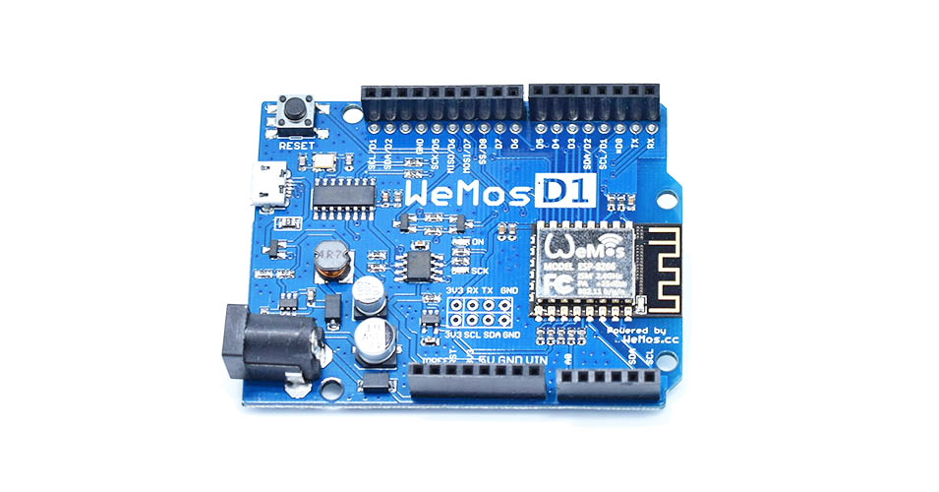
Arduino Uno Compatible!
$7
Wemos D1 R2

Slide 45
NodeMCU Firmware
https://github.com/nodemcu/nodemcu-firmware
Companion project for the open source NodeMCU Dev Kit hardware (but will work on any ESP8266)
SDK is abstracted through a Lua language service/REPL
Firmware is the “Operating System”
Scripts are the “Application”
40+ modules to interface with internal and external hardware

Slide 46
Lua Scripts
eLua (NodeMCU Firmware)
NODE
GPIO
HTTP
RTC
SJSON
FILE
CRYPTO
ADC
MQTT
NET
SPI
WIFI
ESP8266 SDK
AI Thinker ESP-12F Module
ESP8266 Microcontroller + Wi-Fi
Flash Memory

Slide 47
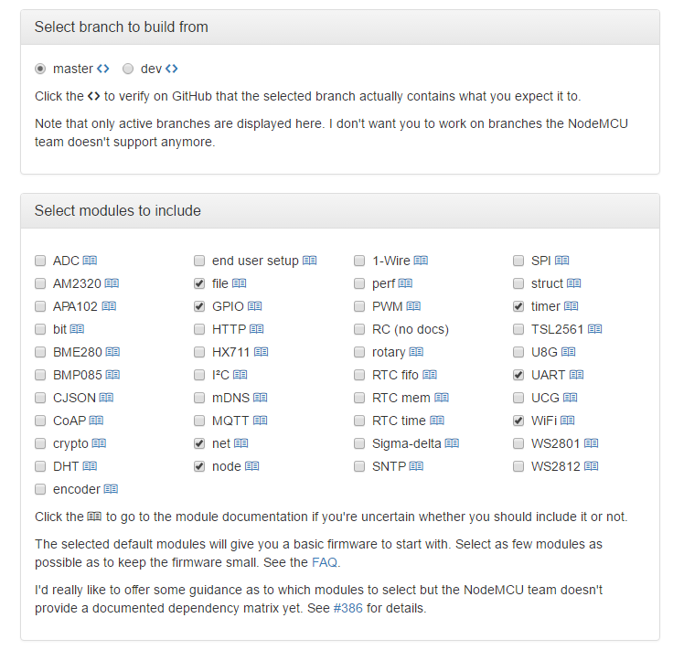
Build the Firmware
http://nodemcu-build.com/

Slide 48
Build the Firmware Yourself
Need Linux* (a virtual machine or WSL will work on Win10)
Need Xtensa Toolchain (for cross compiling)
Need NodeMCU Firmware Source Code
*Linux not absolutely required, but is the first-class environment that will be the easiest to get going

Slide 49
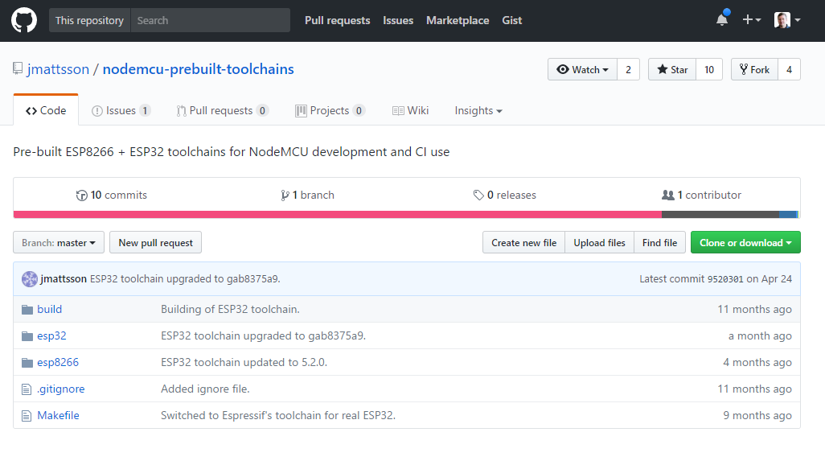
Build the Firmware Yourself: Toolchain

Slide 50
Flashing the Firmware

Slide 51
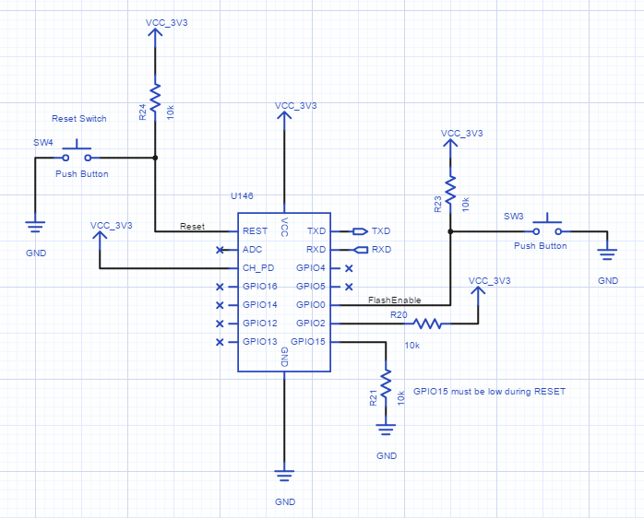
Flashing Firmware: RESET Requirements
GPIO15: Low
GPIO2: High
GPIO0: Low to Flash High to Run

Slide 52
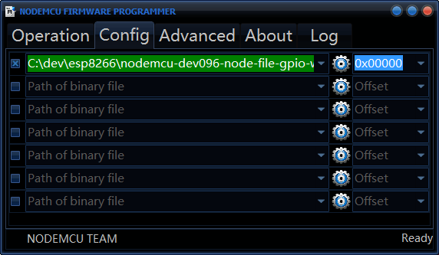
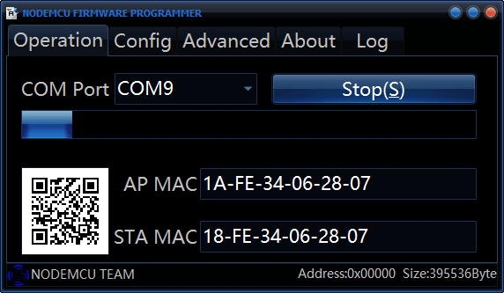
Flashing Firmware: NodeMCU Firmware Programmer

Slide 53
Flashing Firmware: esptool (primarily Linux)
> esptool.py --port /dev/ttyUSB0 write_flash 0x00000 firmware.bin
Connecting...
Erasing flash...
Writing at 0x00000000... (0 %)
https://github.com/themadinventor/esptool
(NOTE: Windows Subsystem for Linux (WSL) does not support COM ports)

Slide 54
A Brief Primer on Lua

Slide 55
Comments
-- This is a comment
--[[
This is a block comment
--]]

Slide 56
Types
nil
boolean
number
string
function
table

Slide 57
Boolean
true or false
In conditionals, false and nil are considered false. Everything else is true
Warning: This means "" and 0 are both considered true

Slide 58
Number
All numbers are double-precision floating points
Still treat integers like integers – the language will sort it out

Slide 59
String
Either single quote ( ' ) or double quotes ( " ) for literals
Concatenation operator is double-dot ( .. )
Lua automatically converts between types:
print("10" + 1) → 11
print("hello" + 1) → ERROR
print("hello" .. 1) → "hello1"

Slide 60
Tables
Associative arrays (key/value pairs)
Used to represent ordinary arrays, sets, records, queues, classes, and other data structures
a = {}
a[1] = "hello"
a["x"] = "world"
print(a.x) → "world"

Slide 61
Relational Operators
<
>
<=
>=
==
~=

Slide 62
Logical Operators
and
or
not
x = x or v → if not x then x = v
a and b or c → a ? b : c

Slide 63
Assignment
> a = "hello" .. "world
> t.n = t.n + 1
> a, b = "hello", "world"
> x, y = y, x

Slide 64
Global Variables
> print(b)
nil
> b = 10
> print(b)
10
> b = nil
> print(b)
nil

Slide 65
Local Variables
> b = 10
> do
>> local b = 12
>> print(b)
>> end
12
> print(b)
10

Slide 66
Control Statements: if then else
> if b == 12 then print("yes") end
> if b == 12 then
>> print("yes")
>> elseif b < 10 then
>> print("no")
>> else
>> print("don't know")
>> end

Slide 67
Control Statements: while
> while true do
>> print("The Neverending Story!")
>> end

Slide 68
Control Statements: for
> for i=1,10 do
>> print(i)
>> end
> for i=10,1,-1 do
>> print(i)
>> if i == 5 then break end
>> end

Slide 69
Control Statements: for (with iterator)
> for k,v in pairs(_G) do
>> print(k)
>> end

Slide 70
Functions
> function add(a,b)
>> return a+b
>> end
> print(add(1,2))
3

Slide 71
Functions: Multiple return values
> function foo()
>> return 1, 2, 3, 4
>> end
> a, b, c, d = foo()
> a, b = foo()
> a, _, _, d = foo()
> a, b, c, d, e, f = foo()

Slide 72
Functions: Calling an instance function
> function MyClass.foo(self)
>> return 123
>> end
> a = MyClass.foo(some_instance)
> a = some_instance:foo()

Slide 73
Write an App

Slide 74
Write an App
Connect to Wi-Fi
Read value from sensor
Publish to MQTT
Repeat

Slide 75
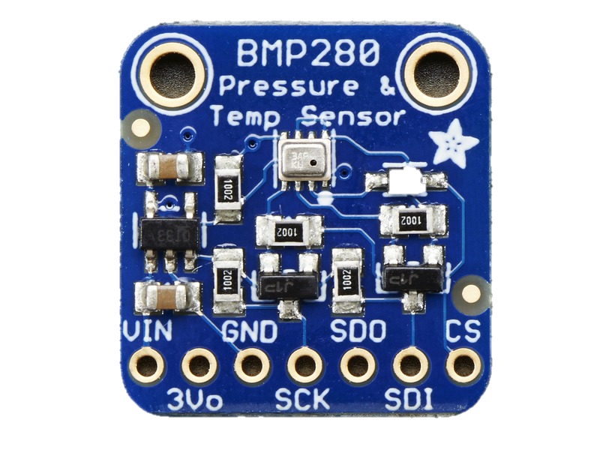
Adafruit BMP280

Slide 76
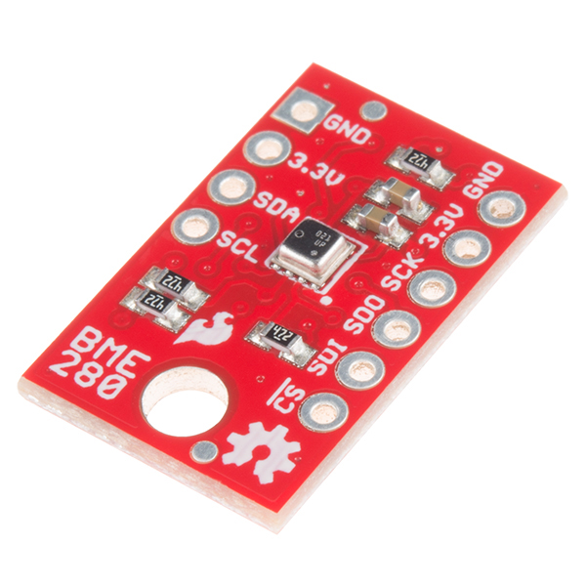
SparkFun BME280

Slide 77
DEMO: Write an App

Slide 78
Gotchas

Slide 79
Memory Issues
At reset without doing anything, we have about 40 KB of RAM available to be used.
When you run out of memory, you die. Known as a Panic-Reset.
This heap is managed by Lua when C allocation is performed by Lua’s alloc
NodeMCU modules can leak if malloc/free is not properly performed
Lua has a garbage collector, but will not free memory that is referenced by something else
This can really hurt when you have chunks that call chunks that call chunks, etc.

Slide 80
Memory Optimization
Use smaller *.lua file sizes
Entire script must be loaded into memory
The longer the script, the less memory is available for data (and other scripts)
Through trial and error, found that < 5 KB was a good target

Slide 81
Memory Optimization
Compile *.lua scripts into bytecode (*.lc files) when possible
All code is compiled into bytecode anyways
node.compile("script.lua")
This removes debugging information
This also prevents the double-memory penalty:
Once for loading the entire script string into memory
Once again for compiling into bytecode (then the string can be freed)
If there’s not enough heap space for both, then it will Panic

Slide 82
Memory Optimization
FlashMod
Technique based on the fact that Lua can provide dynamic function invocation
Functions within a Flash Module are serialized to bytecode and saved in Flash
When invoked, the bytecode is (dynamically) loaded from Flash Memory and then executed
Breaks up a big chunk into lots of little easily-disposed chunks

Slide 83
Memory Optimization
Think of code as tasks
If a chunk of code invokes another chunk, then memory for the first chunk will not be freed until the second is done running
Chunk can instead schedule another chunk to run as a task.
Original Chunk is freed and garbage collected at the end of execution
Lua will run the highest priority task from the task queue next.
This has the same effect as calling a function, with different semantics

Slide 84
Exciting things are in the works!

Slide 85
The future is Now! ESP32
New chip based on two cores
One core for your app
One core dedicated to its hardware
More RAM
More GPIO
Faster Wi-Fi
Bluetooth (BLE)
All on a single chip
For a little more money

Slide 86
Thanks for Listening!

Slide 87
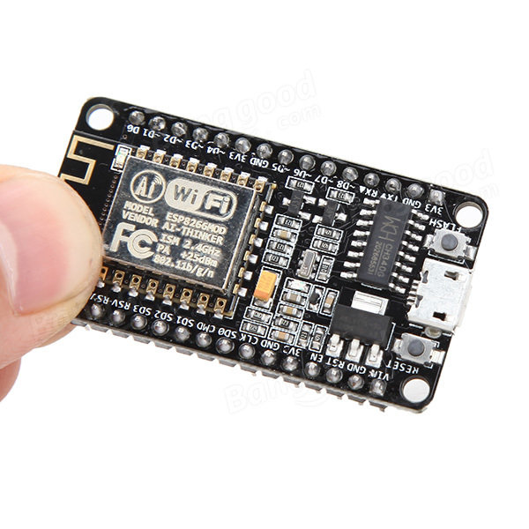
Resources
NodeMCU Firmware https://github.com/nodemcu/nodemcu-firmware
NodeMCU Build http://nodemcu-build.com/
A good $7 NodeMCU DevKit sold by Banggood http://bit.ly/28Uwc4x

Slide 88
Resources
ESP8266.com http://esp8266.com/
AdaFruit https://www.adafruit.com/
Lua 5.1 Reference https://www.lua.org/manual/5.1/

Slide 89


Contact Information
Jason Follas
Quicken Loans
jasonfollas@quickenloans.com
Twitter: @jfollas
This presentation and code can be found here: https://github.com/jfollas/mqttdemo
#10
#1

